Slide 1

William Stallings Computer Organization and Architecture 9th Edition
Notes:
Lecture slides prepared for “Computer Organization and Architecture”, 9/e, by William Stallings, Chapter 10 “Computer Arithmetic”.

Slide 2
Bölüm 10
Bilgisayar Aritmetiği
Notes:
We begin our examination of the processor with an overview of the arithmetic and
logic unit (ALU). The chapter then focuses on the most complex aspect of the ALU,
computer arithmetic. The logic functions that are part of the ALU are described in
Chapter 12, and implementations of simple logic and arithmetic functions in digital
logic are described in Chapter 11.
Computer arithmetic is commonly performed on two very different types of
numbers:
integer and floating point. In both cases, the representation chosen is a crucial
design issue and is treated first, followed by a discussion of arithmetic operations.
This chapter includes a number of examples, each of which is highlighted in a
shaded box.

Slide 3
Arithmetic & Logic Unit (Aritmetik ve Mantık Birimi - ALU)
Veriler üzerinde gerçekte aritmetik ve mantıksal işlemlerini gerçekleştiren bilgisayar parçası
Bilgisayar sisteminin diğer tüm unsurları, çoğunlukla ALU'ya işlemek ve ardından sonuçları almak için verileri ALU'ya getirmek için vardır.
İki basamaklı verileri depolayan ve basit Boolean mantığı işlemleri gerçekleştirebilen basit sayısal lojik cihazların kullanımına dayanır.
Notes:
The ALU is that part of the computer that actually performs arithmetic and logical
operations on data. All of the other elements of the computer system—control unit,
registers, memory, I/O—are there mainly to bring data into the ALU for it to process
and then to take the results back out. We have, in a sense, reached the core or
essence of a computer when we consider the ALU.
An ALU and, indeed, all electronic components in the computer are based on
the use of simple digital logic devices that can store binary digits and perform simple
Boolean logic operations.

Slide 4
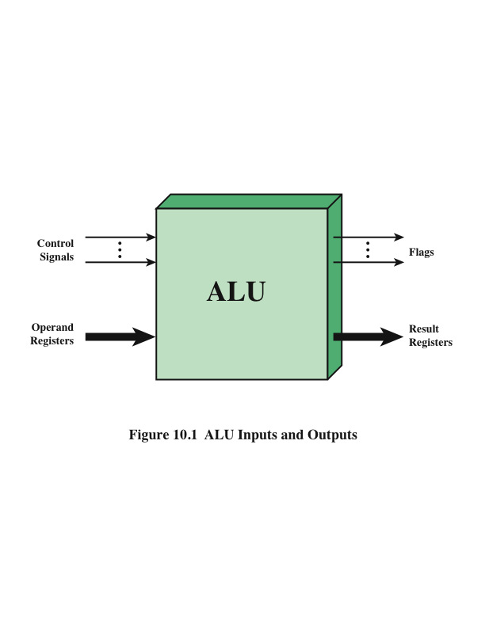
ALU Giriş ve Çıkışları
Notes:
Figure 10.1 indicates, in general terms, how the ALU is interconnected with
the rest of the processor. Operands for arithmetic and logic operations are presented
to the ALU in registers, and the results of an operation are stored in registers.
These registers are temporary storage locations within the processor that are
connected by signal paths to the ALU (e.g., see Figure 2.3). The ALU may also set
flags as the result of an operation. For example, an overflow flag is set to 1 if the
result of a computation exceeds the length of the register into which it is to be stored.
The flag values are also stored in registers within the processor. The processor
provides signals that control the operation of the ALU and the movement of the
data into and out of the ALU.

Slide 5
Tamsayı (Integer) Temsili
İkili sayı sisteminde sayılar şu şekilde temsil edilebilir:
Her bir basamakta 0 veya 1
Eksi işareti (negatif sayılar için)
Devirli veya kesir ayrımı (kesirli bileşenli rakamlar için)
Bilgisayarın depolanması ve işlenmesi amacıyla eksi işareti ve radix noktası için özel sembollerin yararı yoktur.
Sayıları temsil etmek için yalnızca ikili basamaklar (0,1) kullanılabilir
Notes:
In the binary number system, arbitrary numbers can be represented with just the
digits zero and one, the minus sign (for negative numbers), and the period, or radix
point (for numbers with a fractional component).
For purposes of computer storage and processing, however, we do not have the benefit
of special symbols for the minus sign and radix point. Only binary digits (0 and 1)
may be used to represent numbers. If we are limited to nonnegative integers, the
representation is straightforward.

Slide 6
İşaretli-Genlik (Sign-Magnitude) Temsili
Negatif ve pozitif tam sayıları temsil etmek için kullanılan birkaç alternatif yöntem vardır
Bu alternatiflerin tümü, sözcükteki en önemli (en soldaki) biti işaret biti olarak ifade eder
İşaret biti 0 ise sayı pozitiftir
İşaretli genlik gösterimi, bir işaret bitin ifade edilmesi için en basit biçimdir
Sakıncaları
Toplama ve çıkarma, gerekli işlemleri gerçekleştirmek için sayıların işaretlerini ve bunların göreli büyüklüklerini göz önünde bulundurmayı gerektirir
Bu dezavantajlar nedeniyle, ALU'nun tamsayı bölümünün uygulanmasında işaret büyüklüğü gösterimi nadiren kullanılır
İşaret biti 1 ise sayı negatiftir
0‘ için iki gösterim var
Notes:
There are several alternative conventions used to represent negative as well as positive
integers, all of which involve treating the most significant (leftmost) bit in the
word as a sign bit. If the sign bit is 0, the number is positive; if the sign bit is 1, the
number is negative.
The simplest form of representation that employs a sign bit is the sign-magnitude
representation. In an n-bit word, the rightmost n - 1 bits hold the
magnitude of the integer.
There are several drawbacks to sign-magnitude representation. One is that addition
and subtraction require a consideration of both the signs of the numbers and their
relative magnitudes to carry out the required operation. This should become clear in the
discussion in Section 10.3. Another drawback is that there are two representations of 0:
This is inconvenient because it is slightly more difficult to test for 0 (an operation
performed frequently on computers) than if there were a single representation.
Because of these drawbacks, sign-magnitude representation is rarely used in
implementing the integer portion of the ALU. Instead, the most common scheme is
twos complement representation.

Slide 7
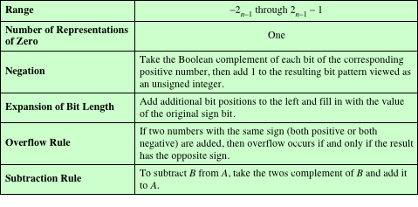
İkiye Tümleyen (Twos Complement) Gösterimi
En önemli biti bir işaret biti olarak kullanır.
İşaretli genlik temsiline göre, diğer bitlerin yorumlanması farklıdır.
Table 10.1 Characteristics of Twos Complement Representation and Arithmetic
Notes:
Like sign magnitude, twos complement representation uses the most significant bit
as a sign bit, making it easy to test whether an integer is positive or negative. It
differs
from the use of the sign-magnitude representation in the way that the other
bits are interpreted. Table 10.1 highlights key characteristics of twos complement
representation and arithmetic, which are elaborated in this section and the next.
Most treatments of twos complement representation focus on the rules for
producing negative numbers, with no formal proof that the scheme is valid. Instead,
our presentation of twos complement integers in this section and in Section 10.3 is
based on [DATT93], which suggests that twos complement representation is best
understood by defining it in terms of a weighted sum of bits, as we did previously
for unsigned and sign-magnitude representations. The advantage of this treatment
is that it does not leave any lingering doubt that the rules for arithmetic operations
in twos complement notation may not work for some special cases.

Slide 8
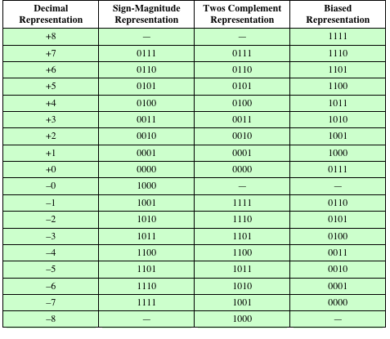
Tablo 10.2 4-Bit Integerlar için Alternatif Temsiller
Notes:
Table 10.2 compares the sign-magnitude and twos complement representations
for 4-bit integers. Although twos complement is an awkward representation
from the human point of view, we will see that it facilitates the most important arithmetic
operations, addition and subtraction. For this reason, it is almost universally
used as the processor representation for integers.

Slide 9
Aralık Uzantısı
İfade edilebilir sayıların aralığı, bit uzunluğunun arttırılmasıyla genişletilir
İşaretli genlik gösteriminde işaret biti en yeni en soldaki yerine taşınır ve sıfırlarla doldurulur
Bu işlem, iki tamsayı negatif tam sayı için çalışmaz
Kural, işaret bitini en yeni en soldaki yerine taşımak ve işaret bitinin kopyaları ile doldurmaktır
Pozitif sayılar için, sıfırlarla doldurun ve negatif sayılar için, 1 ile doldurun
Buna işaret uzantısı denir
Notes:
It is sometimes desirable to take an n-bit integer and store it in m bits, where m 7 n.
This expansion of bit length is referred to as range extension, because the range
of numbers that can be expressed is extended by increasing the bit length.
In sign-magnitude notation, this is easily accomplished: simply move the sign bit
to the new leftmost position and fill in with zeros.
This procedure will not work for twos complement negative integers.
Instead, the rule for twos complement integers is to move the sign bit to the
new leftmost position and fill in with copies of the sign bit. For positive numbers, fill
in with zeros, and for negative numbers, fill in with ones. This is called sign extension.

Slide 10
Sabit Nokta (Fixed-Point ) Gösterimi
Kesir ayrımı (binary point) sabittir ve en sağdaki rakamın sağında olduğu kabul edilir
Programlayıcı, ikili kesirler için aynı gösterimi sayıları ölçekleyerek kullanabilir, böylece ikili nokta örtük olarak başka bir konuma yerleştirilir
Notes:
Finally, we mention that the representations discussed in this section are sometimes
referred to as fixed point. This is because the radix point (binary point) is fixed and
assumed to be to the right of the rightmost digit. The programmer can use the same
representation for binary fractions by scaling the numbers so that the binary point is
implicitly positioned at some other location.

Slide 11
Negation
İkinin tümleyeni işlemi
Integerın tüm bitlerinin boolean tümleyeni alınır (işaret biti de dahil olmak üzere)
Sonuç işaretsiz ikili integer olarak ele alınır, 1 eklenir
Sayının negatifinin negatifi kendisidir:
+18 = 00010010 (ikinin tümleyeni)
Bit seviyesinde tümleyen = 11101101
+ 1
11101110 = -18
-18 = 11101110 (ikinin tümleyeni)
Bit seviyesinde tümleye = 00010001
+ 1
00010010 = +18
Notes:
In sign-magnitude representation, the rule for forming the negation of an integer is
simple: invert the sign bit. In twos complement notation, the negation of an integer
can be formed with the following rules:
1. Take the Boolean complement of each bit of the integer (including the sign
bit). That is, set each 1 to 0 and each 0 to 1.
2. Treating the result as an unsigned binary integer, add 1.
This two-step process is referred to as the twos complement operation, or the taking
of the twos complement of an integer.
As expected, the negative of the negative of that number is itself:

Slide 12
Negation Özel Durum -1
0 = 00000000 (ikinin tümleyeni)
Bit seviyesinde tümleyen = 11111111
LSB’ye 1 ekle + 1
Sonuç 100000000
Taşma durumu göz ardı edilir:
- 0 = 0
Notes:
There is a carry out of the most significant bit position, which is ignored. The result
is that the negation of 0 is 0, as it should be.

Slide 13
Negation Özel Durum -2
-128 = 10000000 (ikinin tümleyeni)
Bit seviyesinde tümleyen = 01111111
LSB’ye 1 ekle + 1
Sonuç 10000000
Dolayısıyla:
-(-128) = -128 X
MSB (işaret biti) takip edilirse:
Negation süresince değişmeli
Notes:
The second special case is more of a problem. If we take the negation of the bit
pattern of 1 followed by n - 1 zeros, we get back the same number.

Slide 14
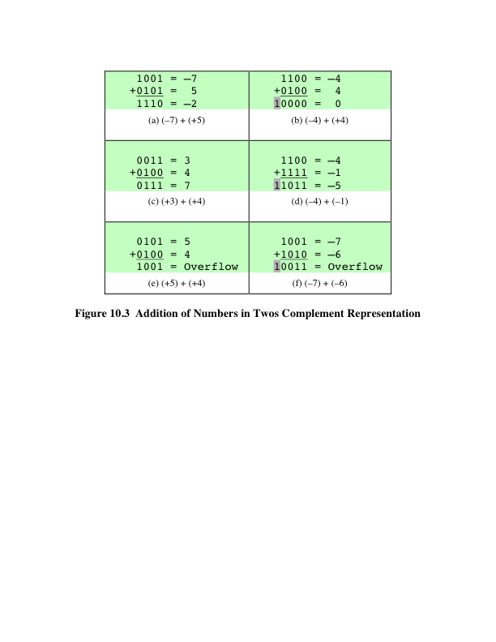
Toplama
Notes:
Addition in twos complement is illustrated in Figure 10.3. Addition proceeds as if
the two numbers were unsigned integers. The first four examples illustrate successful
operations. If the result of the operation is positive, we get a positive number
in twos complement form, which is the same as in unsigned-integer form. If the
result of the operation is negative, we get a negative number in twos complement
form. Note that, in some instances, there is a carry bit beyond the end of the word
(indicated by shading), which is ignored.

Slide 15
Taşma
Taşma Kuralı
İki sayı eklenirse ve ikisi de pozitif veya her ikisi de negatifse, taşma oluşur ve sonuç sadece zıt işaret olur.
Kuralı
Notes:
On any addition, the result may be larger than can be held in the word size
being used. This condition is called overflow. When overflow occurs, the ALU must
signal this fact so that no attempt is made to use the result.
Figures 10.3e and f show examples of overflow. Note that overflow can occur
whether or not there is a carry.

Slide 16
Çıkarma
Çıkarma Kuralı
Bir sayıdan (çıkarılan) birinden (çıkarılmış) çıkarmak için, çıkarılanın ikili tümleyeni (negatif) alıp ekleyelim
Rule
Notes:
Subtraction rule.

Slide 17
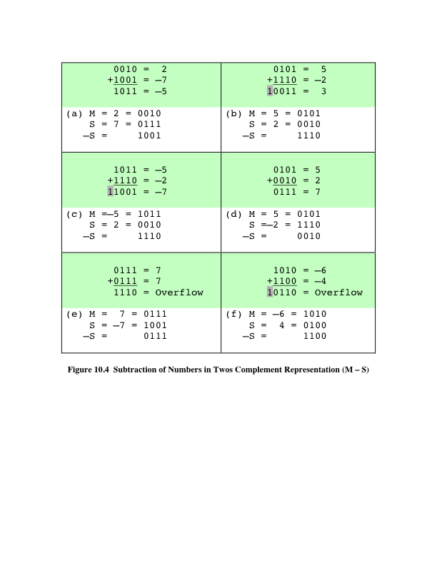
Çıkarma
Notes:
Thus, subtraction is achieved using addition, as illustrated in Figure 10.4. The
last two examples demonstrate that the overflow rule still applies.

Slide 18
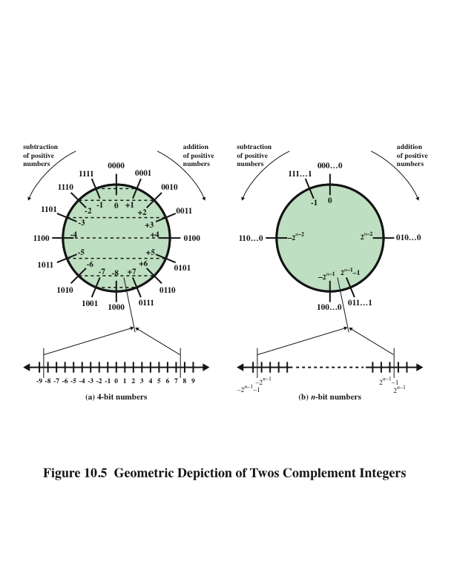
İkiye Tümleyen Tamsayıların Geometrik Çizimi
Notes:
Some insight into twos complement addition and subtraction can be gained by
looking at a geometric depiction [BENH92], as shown in Figure 10.5. The circle in
the upper half of each part of the figure is formed by selecting the appropriate segment
of the number line and joining the endpoints. Note that when the numbers are
laid out on a circle, the twos complement of any number is horizontally opposite that
number (indicated by dashed horizontal lines). Starting at any number on the circle,
we can add positive k (or subtract negative k) to that number by moving k positions
clockwise, and we can subtract positive k (or add negative k) from that number by
moving k positions counterclockwise. If an arithmetic operation results in traversal
of the point where the endpoints are joined, an incorrect answer is given (overflow).

Slide 19
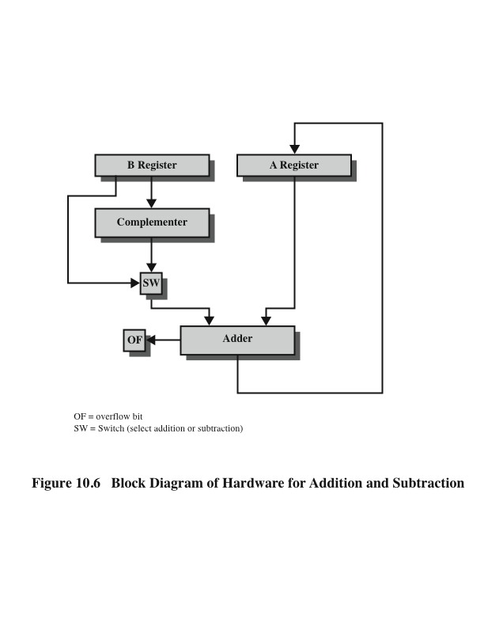
Toplama ve Çıkarma için Donanım
Notes:
Figure 10.6 suggests the data paths and hardware elements needed to accomplish
addition and subtraction. The central element is a binary adder, which is presented
two numbers for addition and produces a sum and an overflow indication.
The binary adder treats the two numbers as unsigned integers. (A logic implementation
of an adder is given in Chapter 11.) For addition, the two numbers are
presented to the adder from two registers, designated in this case as A and B registers.
The result may be stored in one of these registers or in a third. The overflow
indication is stored in a 1-bit overflow flag (0 = no overflow; 1 = overflow). For
subtraction, the subtrahend (B register) is passed through a twos complementer
so that its twos complement is presented to the adder. Note that Figure 10.6 only
shows the data paths. Control signals are needed to control whether or not the complementer
is used, depending on whether the operation is addition or subtraction.

Slide 20
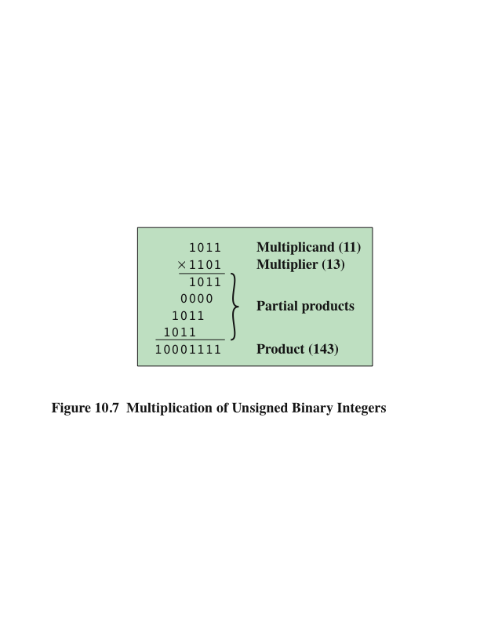
Çarpma
Notes:
Compared with addition and subtraction, multiplication is a complex operation,
whether performed in hardware or software. A wide variety of algorithms have been
used in various computers. The purpose of this subsection is to give the reader some
feel for the type of approach typically taken. We begin with the simpler problem of
multiplying two unsigned (nonnegative) integers, and then we look at one of the most
common techniques for multiplication of numbers in twos complement representation.
Figure 10.7 illustrates the multiplication of unsigned
binary integers, as might be carried out using paper and pencil. Several important
observations can be made:
1. Multiplication involves the generation of partial products, one for each digit in the
multiplier. These partial products are then summed to produce the final product.
2. The partial products are easily defined. When the multiplier bit is 0, the partial
product is 0. When the multiplier is 1, the partial product is the multiplicand.
3. The total product is produced by summing the partial products. For this operation,
each successive partial product is shifted one position to the left relative
to the preceding partial product.
4. The multiplication of two n-bit binary integers results in a product of up to 2n
bits in length (e.g., 11 * 11 = 1001).
Compared with the pencil-and-paper approach, there are several things we can
do to make computerized multiplication more efficient. First, we can perform a running
addition on the partial products rather than waiting until the end. This eliminates
the need for storage of all the partial products; fewer registers are needed. Second,
we can save some time on the generation of partial products. For each 1 on the multiplier,
an add and a shift operation are required; but for each 0, only a shift is required.

Slide 21
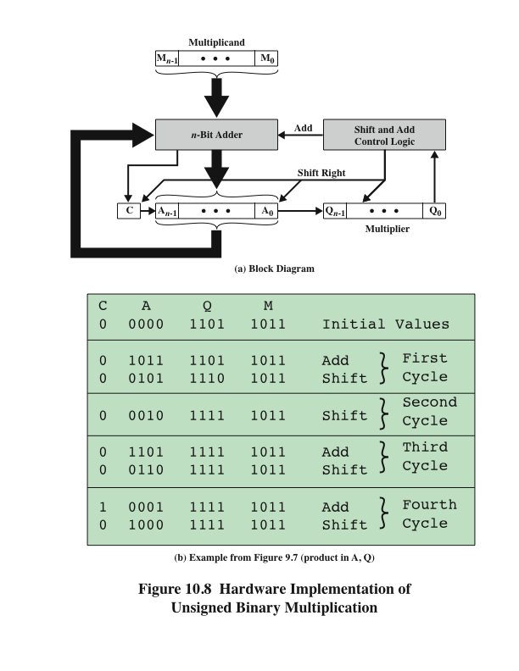
İşaretsiz İkili Sayının Çarpımı için Donanım Gerçeklenmesi
Notes:
Figure 10.8a shows a possible implementation employing these measures. The
multiplier and multiplicand are loaded into two registers (Q and M). A third register,
the A register, is also needed and is initially set to 0. There is also a 1-bit C register,
initialized to 0, which holds a potential carry bit resulting from addition.

Slide 22
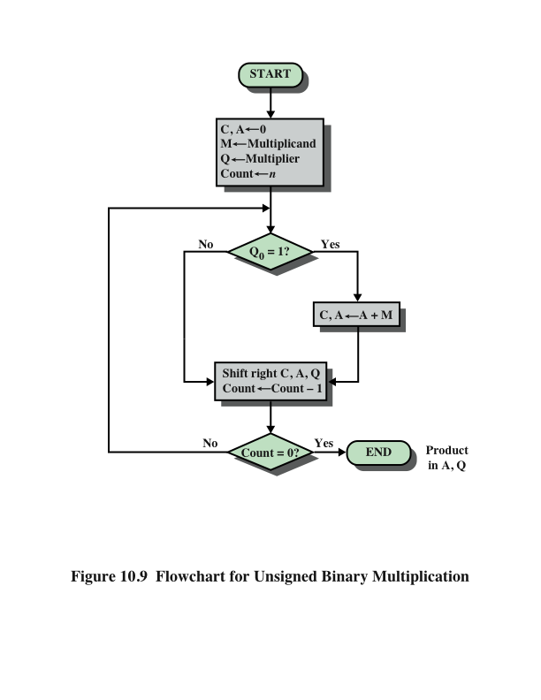
İşaretsiz İkili Sayının Çarpımı için Akış Diyagramı
Notes:
The operation of the multiplier is as follows. Control logic reads the bits of the
multiplier one at a time. If Q₀ is 1, then the multiplicand is added to the A register
and the result is stored in the A register, with the C bit used for overflow. Then all
of the bits of the C, A, and Q registers are shifted to the right one bit, so that the C
bit goes into A_{n-1}, A₀ goes into Q_{n-1} and Q₀ is lost. If Q₀ is 0, then no addition is
performed, just the shift. This process is repeated for each bit of the original multiplier.
The resulting 2n-bit product is contained in the A and Q registers. A flowchart
of the operation is shown in Figure 10.9, and an example is given in Figure 10.8b.
Note that on the second cycle, when the multiplier bit is 0, there is no add operation.

Slide 23
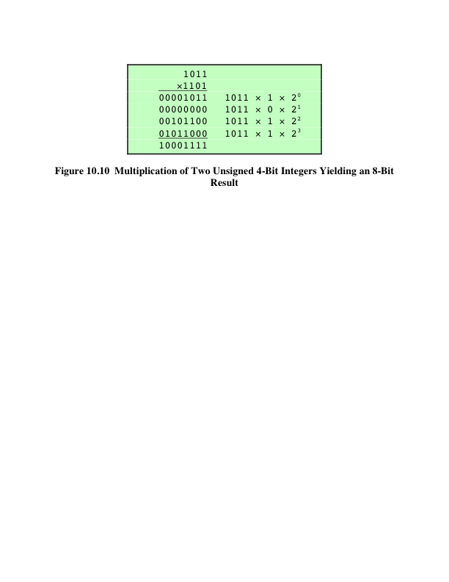
İkiye Tümleyenlerin Çarpımı
Notes:
Figure 10.10 recasts Figure 10.7 to make the generation of partial products by multiplication explicit.
The only difference in Figure 10.10 is that it recognizes that the partial products
should be viewed as 2n-bit numbers generated from the n-bit multiplicand.

Slide 24
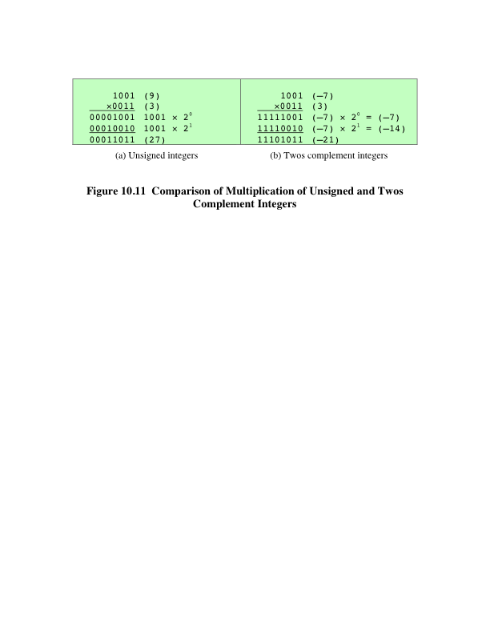
Karşılaştırma
Notes:
Now we can demonstrate that straightforward multiplication will not work if
the multiplicand is negative. The problem is that each contribution of the negative
multiplicand as a partial product must be a negative number on a 2n-bit field; the sign
bits of the partial products must line up. This is demonstrated in Figure 10.11, which
shows that multiplication of 1001 by 0011. If these are treated as unsigned integers,
the multiplication of 9 * 3 = 27 proceeds simply. However, if 1001 is interpreted
as the twos complement value -7, then each partial product must be a negative
twos complement number of 2n (8) bits, as shown in Figure 10.11b. Note that this is
accomplished by padding out each partial product to the left with binary 1s.

Slide 25
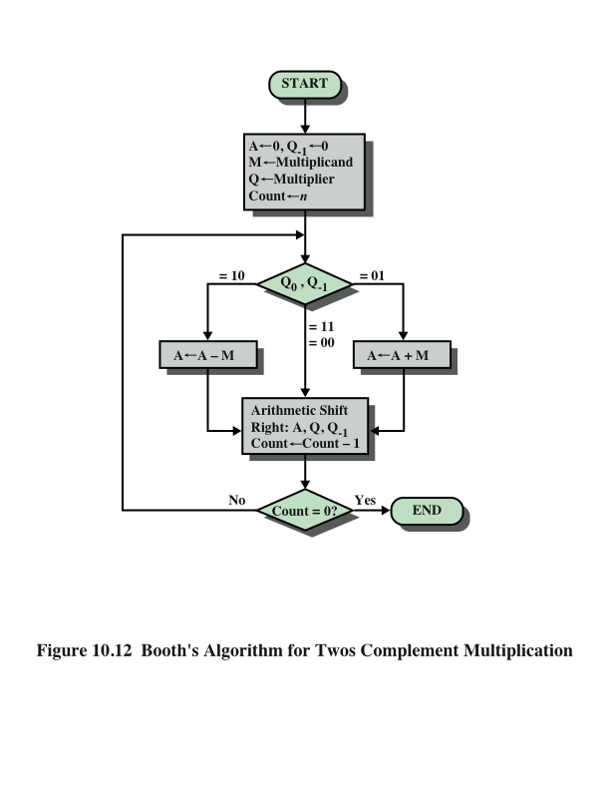
Booth’s
Algoritması
Notes:
Booth’s algorithm is depicted in Figure 10.12 and can be described as follows.
As before, the multiplier and multiplicand are placed in the Q and M registers,
respectively. There is also a 1-bit register placed logically to the right of the least
significant bit (Q₀) of the Q register and designated Q₋₁ its use is explained shortly.
The results of the multiplication will appear in the A and Q registers. A and Q₋₁
are initialized to 0. As before, control logic scans the bits of the multiplier one at a
time. Now, as each bit is examined, the bit to its right is also examined. If the two
bits are the same (1–1 or 0–0), then all of the bits of the A, Q, and Q₋₁ registers are
shifted to the right 1 bit. If the two bits differ, then the multiplicand is added to or
subtracted from the A register, depending on whether the two bits are 0–1 or 1–0.
Following the addition or subtraction, the right shift occurs. In either case, the right
shift is such that the leftmost bit of A, namely, A_{n-1} not only is shifted into A_{n-2},
but also remains in A_{n-1}. This is required to preserve the sign of the number in A
and Q. It is known as an arithmetic shift, because it preserves the sign bit.

Slide 26
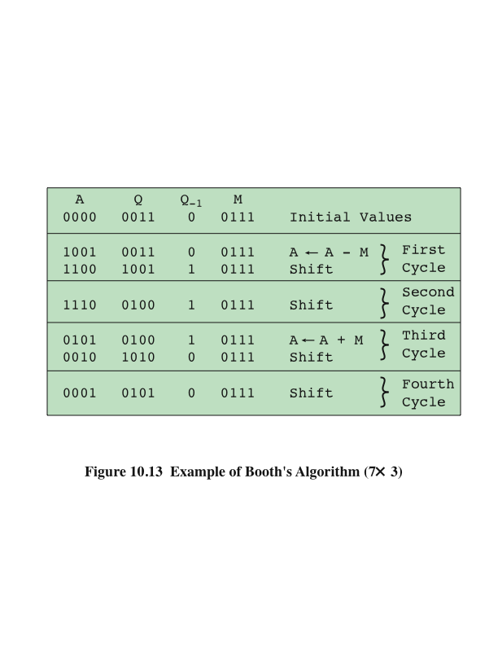
Booth Algoritması Örneği
Notes:
Figure 10.13 shows the sequence of events in Booth’s algorithm for the multiplication
of 7 by 3.

Slide 27
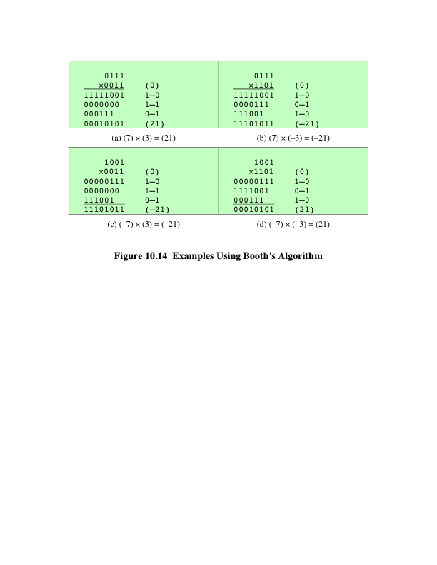
Booth Algoritması Örnekleri
Notes:
More compactly, the same operation is depicted in Figure 10.14a.
The rest of Figure 10.14 gives other examples of the algorithm. As can be seen, it
works with any combination of positive and negative numbers. Note also the efficiency
of the algorithm. Blocks of 1s or 0s are skipped over, with an average of only
one addition or subtraction per block.

Slide 28
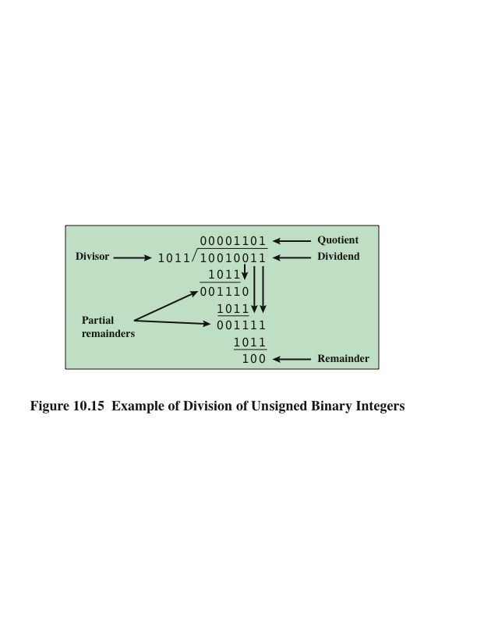
Bölme
Notes:
Division is somewhat more complex than multiplication but is based on the same
general principles. As before, the basis for the algorithm is the paper-and-pencil
approach, and the operation involves repetitive shifting and addition or subtraction.
Figure 10.15 shows an example of the long division of unsigned binary integers.
It is instructive to describe the process in detail. First, the bits of the dividend
are examined from left to right, until the set of bits examined represents a number
greater than or equal to the divisor; this is referred to as the divisor being able to
divide the number. Until this event occurs, 0s are placed in the quotient from left
to right. When the event occurs, a 1 is placed in the quotient and the divisor is subtracted
from the partial dividend. The result is referred to as a partial remainder.
From this point on, the division follows a cyclic pattern. At each cycle, additional
bits from the dividend are appended to the partial remainder until the result is
greater than or equal to the divisor. As before, the divisor is subtracted from this
number to produce a new partial remainder. The process continues until all the bits
of the dividend are exhausted.

Slide 29
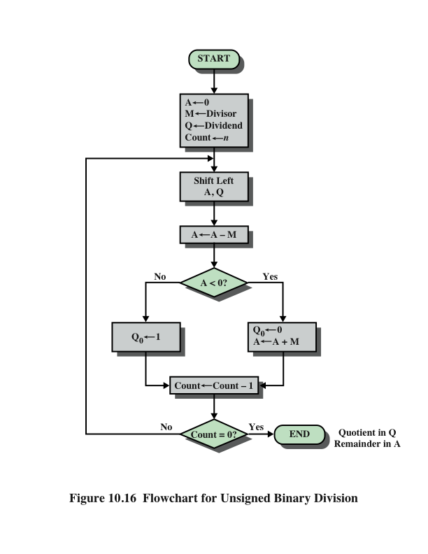
İşaretsiz İkili Sayıların Bölme İşlemi Akış Diyagramı
Notes:
Figure 10.16 shows a machine algorithm that corresponds to the long division
process.

Slide 30
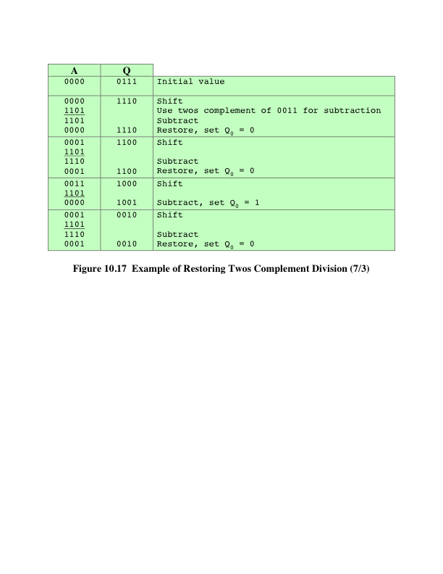
İkiye Tümleyenin Bölme İşleminin Geri Alınması Örneği
Notes:
Example of restoring twos complement division.

Slide 31
Kayan Noktalı Temsil
Prensipler
Sabit noktalı gösterim ile 0 veya yakınındaki pozitif ve negatif tamsayıların aralığı temsil edilebilir
Sabit ikili veya radix bir nokta varsayarsak, bu format, kesirli bir bileşene sahip sayılar temsil edilir
Sınırlamalar:
Çok büyük sayıları veya çok küçük kesirleri temsil edemez
İki büyük sayının bölme işleminde bölümün kesirli kısmı yok olabilir
Notes:
With a fixed-point notation (e.g., twos complement) it is possible to represent a
range of positive and negative integers centered on or near 0. By assuming a fixed
binary or radix point, this format allows the representation of numbers with a fractional
component as well.
This approach has limitations. Very large numbers cannot be represented, nor
can very small fractions. Furthermore, the fractional part of the quotient in a division
of two large numbers could be lost.

Slide 32
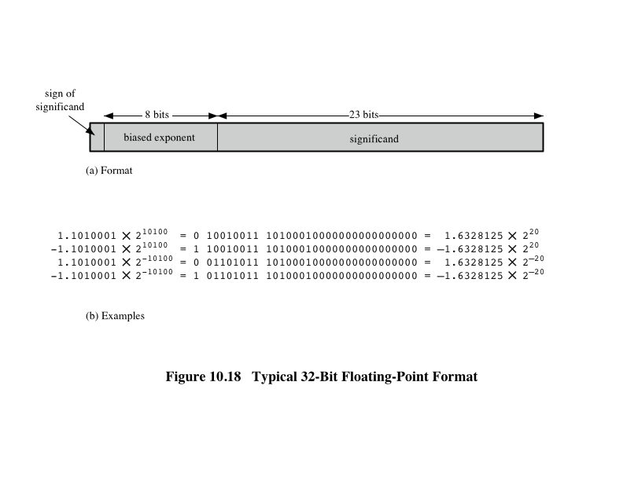
Tipik 32-Bit Kayan-Noktalı Format
Notes:
The principles used in representing binary floating-point numbers are best
explained with an example. Figure 10.18a shows a typical 32-bit floating-point format.
The leftmost bit stores the sign of the number (0 = positive, 1 = negative).
The exponent value is stored in the next 8 bits. The representation used is known as
a biased representation. A fixed value, called the bias, is subtracted from the field
to get the true exponent value. Typically, the bias equals (2^{k-1} - 1), where k is the
number of bits in the binary exponent. In this case, the 8-bit field yields the numbers
0 through 255. With a bias of 127 (2⁷ - 1), the true exponent values are in the range
-127 to +128. In this example, the base is assumed to be 2.

Slide 33
Kayan-Noktalı
Significand
Kelimenin son kısmı
Herhangi bir kayan noktalı sayı pek çok farklı şekilde temsil edilebilir
Normal sayı
Significandın en önemli basamağı 0’dan farklıdır
Aşağıdakiler birbiriyle aynı, en anlamlı kısımları 2li formda temsil edilmiş:
0.110 * 2⁵
110 * 2²
0.0110 * 2⁶
Notes:
Table 10.2 shows the biased representation for 4-bit integers. Note that when
the bits of a biased representation are treated as unsigned integers, the relative magnitudes
of the numbers do not change. For example, in both biased and unsigned
representations, the largest number is 1111 and the smallest number is 0000. This is
not true of sign-magnitude or twos complement representation. An advantage of
biased representation is that nonnegative floating-point numbers can be treated as
integers for comparison purposes.
The final portion of the word (23 bits in this case) is the significand.
Any floating-point number can be expressed in many ways.
To simplify operations on floating-point numbers, it is typically required that they
be normalized. A normal number is one in which the most significant digit of the
significand is nonzero. For base 2 representation, a normal number is therefore one
in which the most significant bit of the significand is one.

Slide 34
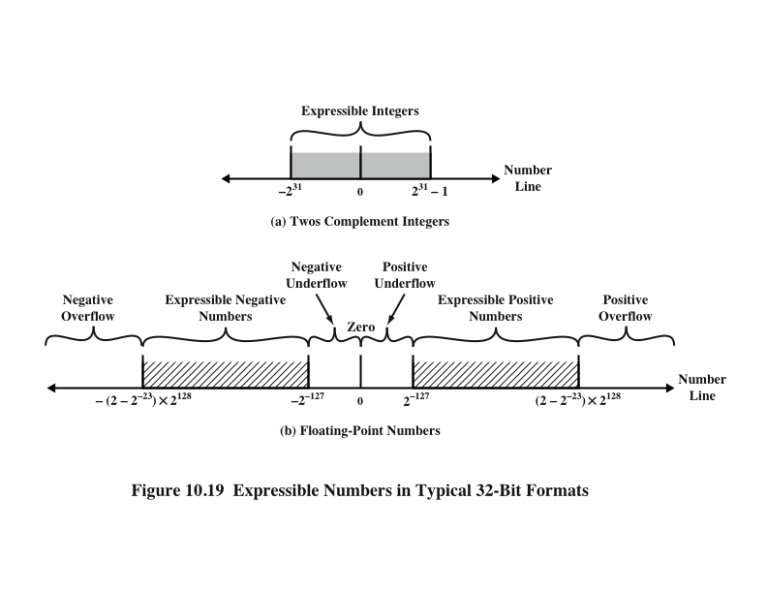
İfade Edilebilir Sayılar
Notes:
Figure 10.19 indicates the range of numbers that can be represented
in a 32-bit word. Using twos complement integer representation, all of the
integers from -2³¹ to 2³¹ - 1 can be represented, for a total of 2³² different numbers.
With the example floating-point format of Figure 10.18, the following ranges
of numbers are possible:
• Negative numbers between -(2 - 2⁻²³) * 2¹²⁸ and -2⁻¹²⁷
• Positive numbers between 2⁻¹²⁷ and (2 - 2⁻²³) * 2¹²⁸
Five regions on the number line are not included in these ranges:
• Negative numbers less than -(2 - 2⁻²³) * 2¹²⁸, called negative overflow
• Negative numbers greater than 2⁻¹²⁷, called negative underflow
• Zero
• Positive numbers less than 2⁻¹²⁷, called positive underflow
• Positive numbers greater than (2 - 2⁻²³) * 2¹²⁸, called positive overflow
The representation as presented will not accommodate a value of 0.
However, as we shall see, actual floating-point representations include a special
bit pattern to designate zero. Overflow occurs when an arithmetic operation
results in an absolute value greater than can be expressed with an exponent of 128
(e.g., 2¹²⁰ * 2¹⁰⁰ = 2²²⁰). Underflow occurs when the fractional magnitude is too
small (e.g., 2⁻¹²⁰ * 2⁻¹⁰⁰ = 2⁻²²⁰). Underflow is a less serious problem because
the result can generally be satisfactorily approximated by 0.
It is important to note that we are not representing more individual values
with floating-point notation. The maximum number of different values that can be
represented with 32 bits is still 2³². What we have done is to spread those numbers
out in two ranges, one positive and one negative. In practice, most floating-point
numbers that one would wish to represent are represented only approximately.
However, for moderate sized integers, the representation is exact.

Slide 35
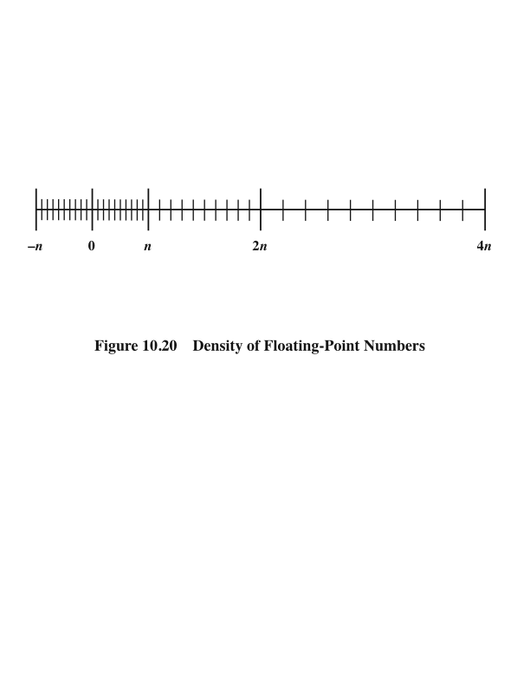
Kayan-Noktalı Sayıların Yoğunluğu
Notes:
Also, note that the numbers represented in floating-point notation are not
spaced evenly along the number line, as are fixed-point numbers. The possible values
get closer together near the origin and farther apart as you move away, as shown
in Figure 10.20. This is one of the trade-offs of floating-point math: Many calculations
produce results that are not exact and have to be rounded to the nearest value
that the notation can represent.

Slide 36
IEEE Standard 754
En önemli kayan noktalı gösterimi tanımlanır
Standart, programların bir işlemciden diğerine taşınmasını kolaylaştırmak ve gelişmiş sayısal odaklı programların geliştirilmesini teşvik etmek için geliştirildi
Standart yaygın olarak benimsenmiştir ve hemen hemen tüm çağdaş işlemciler ve aritmetik yardımcı işlemciler üzerinde kullanılmaktadır.
IEEE 754-2008, hem ikili hem de desimal kayan nokta gösterimlerini kapsar
Notes:
The most important floating-point representation is defined in IEEE Standard 754,
adopted in 1985 and revised in 2008. This standard was developed to facilitate the
portability of programs from one processor to another and to encourage the development
of sophisticated, numerically oriented programs. The standard has been
widely adopted and is used on virtually all contemporary processors and arithmetic
coprocessors. IEEE 754-2008 covers both binary and decimal floating-point representations.
In this chapter, we deal only with binary representations.

Slide 37
IEEE 754-2008
Aşağıdaki kayan nokta biçimlerini tanımlar :
Aritmetik format
Standart tarafından tanımlanan tüm zorunlu işlemler format tarafından desteklenir. Format, kayan nokta operandlarını veya standartta açıklanan işlemlerin sonuçlarını temsil etmek için kullanılabilir.
Temel format
Bu format, kodlamaları standart tarafından belirtilen ve aritmetik için kullanılabilen beş temsili kapsar; üç ikili ve iki desimal kayan nokta. Temel formatlardan en az biri uygun herhangi bir uygulamada uygulanmaktadır.
Değişebilir format
Farklı platformlar arasında veri alışverişine izin veren ve depolama için kullanılabilen tam olarak belirtilen, sabit uzunlukta bir ikili kodlama.
Notes:
IEEE 754-2008 defines the following different types of floating-point formats:
• Arithmetic format: All the mandatory operations defined by the standard are
supported by the format. The format may be used to represent floating-point
operands or results for the operations described in the standard.
• Basic format: This format covers five floating-point representations, three
binary and two decimal, whose encodings are specified by the standard, and
which can be used for arithmetic. At least one of the basic formats is implemented
in any conforming implementation.
• Interchange format: A fully specified, fixed-length binary encoding that allows
data interchange between different platforms and that can be used for storage.

Slide 38
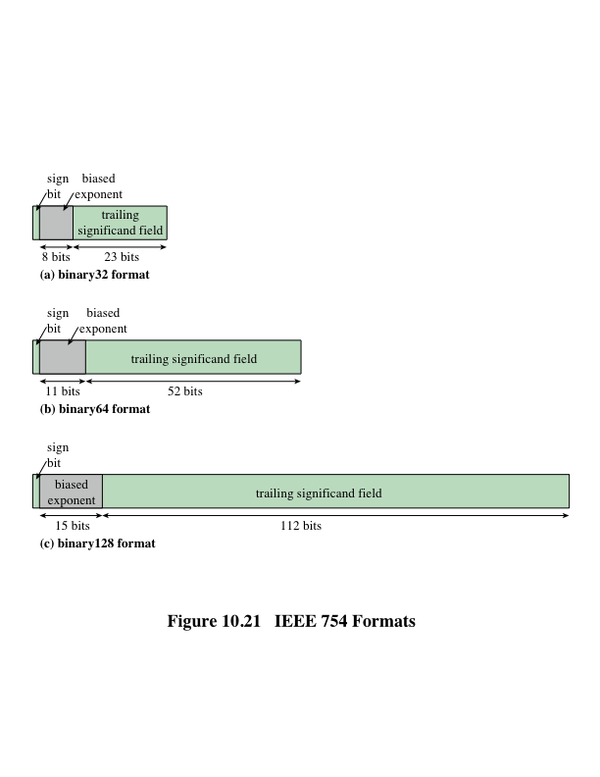
IEEE 754 Formats
Notes:
The three basic binary formats have bit lengths of 32, 64, and 128 bits, with
exponents of 8, 11, and 15 bits, respectively (Figure 10.21).

Slide 39
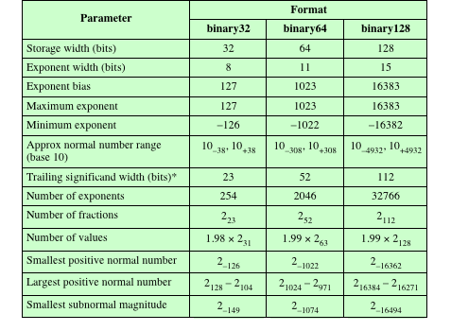
Tablo 10.3
IEEE 754
Format
Parametreleri
* not including implied bit and not including sign bit
Notes:
Table 10.3 summarizes
the characteristics of the three formats. The two basic decimal formats have bit
lengths of 64 and 128 bits. All of the basic formats are also arithmetic format types
(can be used for arithmetic operations) and interchange format types (platform
independent).

Slide 40
İlave Formatlar
Genişletilmiş Duyarlılık Formatları
Genişletilmiş Duyarlılık Formatları
Exponent (genişletilmiş aralıkve significand (genişletilmiş duyarlılık) da ekstra bitler sağlar
Aşırı yuvarlanma hatası ile bozulmuş olan nihai sonuca varma şansı azalır
Nihai sonucu basit bir biçimde temsil edilebilecek bir hesaplamayı iptal eden bir ara taşma şansını azaltır
Genellikle yüksek hassasiyetle ilişkili zaman cezası ile karşılaşmadan daha büyük bir temel formatın faydalarından bazılarını sağlar
Hassasiyet ve aralık, kullanıcı kontrolü altında tanımlanır
Ara hesaplamalar için kullanılabilir ancak standart yerlerde kısıtlama veya format veya uzunluk yoktur
Notes:
In addition, the standard defines extended precision formats, which
extend a supported basic format by providing additional bits in the exponent
(extended range) and in the significand (extended precision). The exact format
is implementation dependent, but the standard places certain constraints on the
length of the exponent and significand. These formats are arithmetic format types
but not interchange format types. The extended formats are to be used for intermediate
calculations. With their greater precision, the extended formats lessen the
chance of a final result that has been contaminated by excessive round-off error;
with their greater range, they also lessen the chance of an intermediate overflow
aborting a computation whose final result would have been representable in a basic
format. An additional motivation for the extended format is that it affords some
of the benefits of a larger basic format without incurring the time penalty usually
associated with higher precision.
Finally, IEEE 754-2008 defines an extendable precision format as a format
with a precision and range that are defined under user control. Again, these formats
may be used for intermediate calculations, but the standard places no constraint or
format or length.

Slide 41
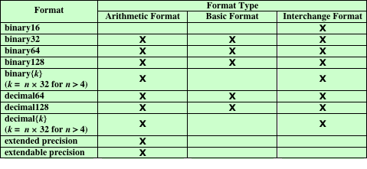
Tablo 10.4 IEEE Formatları
Tablo 10.4 IEEE Formatları
Notes:
Table 10.4 shows the relationship between defined formats and format types.

Slide 42
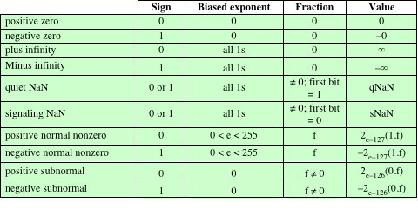
IEEE 754 Kayan Noktalı Sayıların
Yorumlanması
(a) İkili 32 format
Table 10.5 IEEE 754 Kayan Noktalı Sayıların Yorumlanması (Sayfa 1/3)
Notes:
Not all bit patterns in the IEEE formats are interpreted in the usual way;
instead, some bit patterns are used to represent special values. Table 10.5 indicates
the values assigned to various bit patterns. The exponent values of all zeros (0 bits)
and all ones (1 bits) define special values.
The following classes of numbers are
represented:
• For exponent values in the range of 1 through 254 for 32-bit format, 1 through
2046 for 64-bit format, and 1 through 16382, normal nonzero floating-point
numbers are represented. The exponent is biased, so that the range of exponents
is -126 through +127 for 32-bit format, and so on. A normal number
requires a 1 bit to the left of the binary point; this bit is implied, giving an
effective 24-bit, 53-bit, or 113-bit significand. Because one of the bits is implied,
the corresponding field in the binary format is referred to as the trailing
significand field.
• An exponent of zero together with a fraction of zero represents positive or
negative zero, depending on the sign bit. As was mentioned, it is useful to have
an exact value of 0 represented.
• An exponent of all ones together with a fraction of zero represents positive
or negative infinity, depending on the sign bit. It is also useful to have a representation
of infinity. This leaves it up to the user to decide whether to treat
overflow as an error condition or to carry the value and proceed with whatever
program is being executed.
• An exponent of zero together with a nonzero fraction represents a subnormal
number. In this case, the bit to the left of the binary point is zero and the true
exponent is -126 or -1022. The number is positive or negative depending on
the sign bit.
• An exponent of all ones together with a nonzero fraction is given the value
NaN, which means Not a Number, and is used to signal various exception
conditions.
The significance of subnormal numbers and NaNs is discussed in Section 10.5.

Slide 43
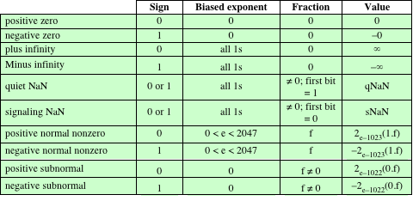
IEEE 754 Kayan Noktalı Sayıların
Yorumlanması
(b) İkili 64 format
Table 10.5 IEEE 754 Kayan Noktalı Sayıların Yorumlanması (Sayfa 2/3)
Notes:
Table 10.5 continued.

Slide 44
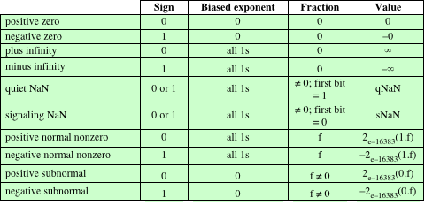
IEEE 754 Kayan Noktalı Sayıların
Yorumlanması
(c) ikili128 format
Table 10.5 IEEE 754 Kayan Noktalı Sayıların Yorumlanması (Sayfa 3/3)
Notes:
Table 10.5 continued.

Slide 45
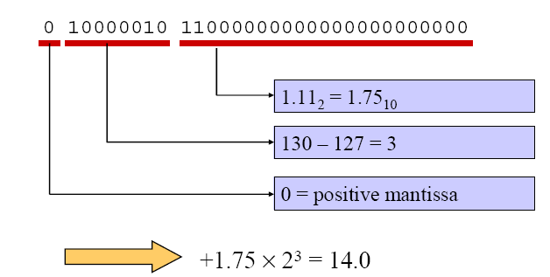
Yuvarlanır Nokta Sayı Formatı

Slide 46
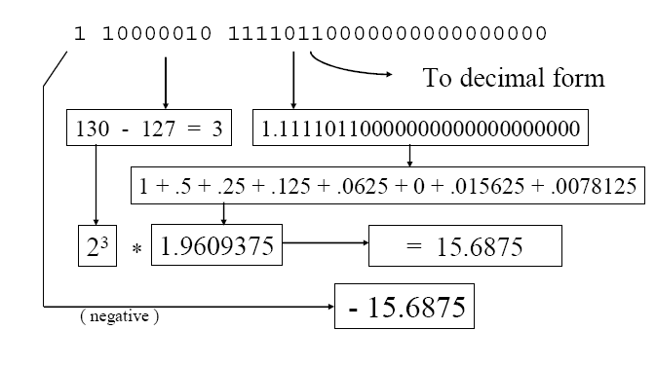
Yuvarlanır Nokta Sayı Formatı

Slide 47
Yuvarlanır Nokta Sayı Formatı
S, F, ve E
36.5625₁₀ =
100100.1001₂
100100.1001₂ =
1.001001001₂ x 2⁵
+1.001001001₂ x 2⁵
S
F
n
E = n + 127
= 5 + 127
= 132
= 10000100₂
S = 0 (pozitif değer)
0 10000100 00100100100000000000000₂
S
E
F

Slide 48
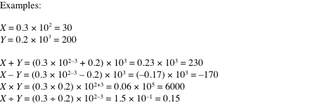
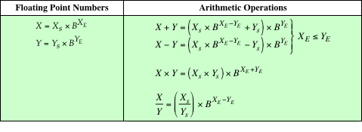
Tablo 10.6 Kayan Noktalı Sayılar ve Aritmetik İşlemler
Notes:
Table 10.6 summarizes the basic operations for floating-point arithmetic. For addition
and subtraction, it is necessary to ensure that both operands have the same
exponent value. This may require shifting the radix point on one of the operands to
achieve alignment. Multiplication and division are more straightforward.
A floating-point operation may produce one of these conditions:
• Exponent overflow: A positive exponent exceeds the maximum possible exponent
value. In some systems, this may be designated as + ∞ or - ∞.
• Exponent underflow: A negative exponent is less than the minimum possible
exponent value (e.g., -200 is less than -127). This means that the number is
too small to be represented, and it may be reported as 0.
• Significand underflow: In the process of aligning significands, digits may flow
off the right end of the significand. As we shall discuss, some form of rounding
is required.
• Significand overflow: The addition of two significands of the same sign may
result in a carry out of the most significant bit. This can be fixed by realignment,
as we shall explain.

Slide 49
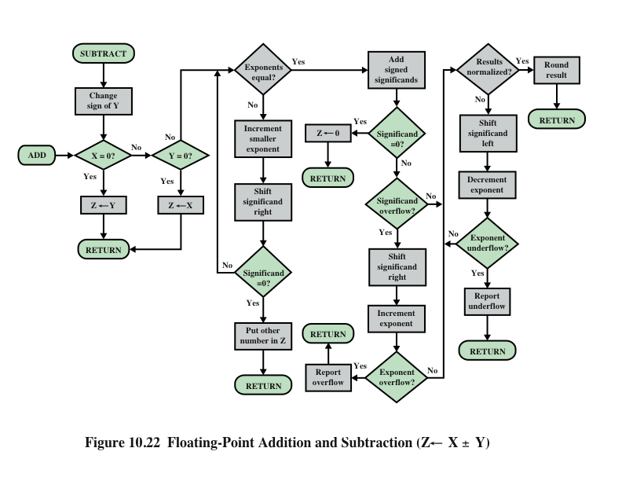
Kayan Noktalılar Toplama ve Çıkartma
Notes:
In floating-point arithmetic, addition and subtraction are more complex than multiplication
and division. This is because of the need for alignment. There are four
basic phases of the algorithm for addition and subtraction:
1. Check for zeros.
2. Align the significands.
3. Add or subtract the significands.
4. Normalize the result.
A typical flowchart is shown in Figure 10.22. A step-by-step narrative highlights
the main functions required for floating-point addition and subtraction. We
assume a format similar to those of Figure 10.21. For the addition or subtraction
operation, the two operands must be transferred to registers that will be used by the
ALU. If the floating-point format includes an implicit significand bit, that bit must
be made explicit for the operation.
Phase 1: Zero check. Because addition and subtraction are identical except
for a sign change, the process begins by changing the sign of the subtrahend if
it is a subtract operation. Next, if either operand is 0, the other is reported as
the result.
Phase 2: Significand alignment. The next phase is to manipulate the numbers
so that the two exponents are equal.
Alignment may be achieved by shifting either the smaller number to the
right (increasing its exponent) or shifting the larger number to the left. Because
either operation may result in the loss of digits, it is the smaller number that is
shifted; any digits that are lost are therefore of relatively small significance. The
alignment is achieved by repeatedly shifting the magnitude portion of the significand
right 1 digit and incrementing the exponent until the two exponents are
equal. (Note that if the implied base is 16, a shift of 1 digit is a shift of 4 bits.) If this
process results in a 0 value for the significand, then the other number is reported
as the result. Thus, if two numbers have exponents that differ significantly, the
lesser number is lost.
Phase 3: Addition. Next, the two significands are added together, taking into
account their signs. Because the signs may differ, the result may be 0. There
is also the possibility of significand overflow by 1 digit. If so, the significand
of the result is shifted right and the exponent is incremented. An exponent
overflow could occur as a result; this would be reported and the operation
halted.
Phase 4: Normalization. The final phase normalizes the result. Normalization
consists of shifting significand digits left until the most significant digit (bit, or
4 bits for base-16 exponent) is nonzero. Each shift causes a decrement of the
exponent and thus could cause an exponent underflow. Finally, the result must
be rounded off and then reported. We defer a discussion of rounding until after
a discussion of multiplication and division.

Slide 50
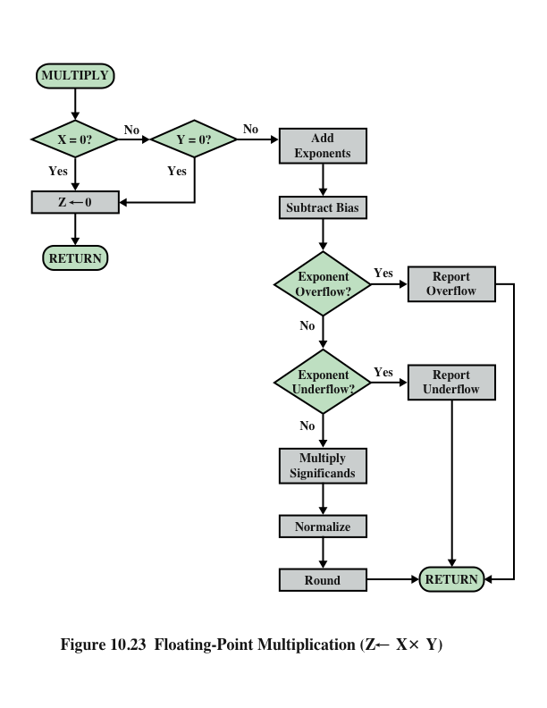
Kayan Noktalı Çarpma
Notes:
Floating-point multiplication and division are much simpler processes than addition
and subtraction, as the following discussion indicates.
We first consider multiplication, illustrated in Figure 10.23. First, if either
operand is 0, 0 is reported as the result. The next step is to add the exponents. If
the exponents are stored in biased form, the exponent sum would have doubled
the bias. Thus, the bias value must be subtracted from the sum. The result could
be either an exponent overflow or underflow, which would be reported, ending the
algorithm.
If the exponent of the product is within the proper range, the next step is to
multiply the significands, taking into account their signs. The multiplication is performed
in the same way as for integers. In this case, we are dealing with a sign-magnitude
representation, but the details are similar to those for twos complement
representation. The product will be double the length of the multiplier and multiplicand.
The extra bits will be lost during rounding.
After the product is calculated, the result is then normalized and rounded,
as was done for addition and subtraction. Note that normalization could result in
exponent underflow.

Slide 51
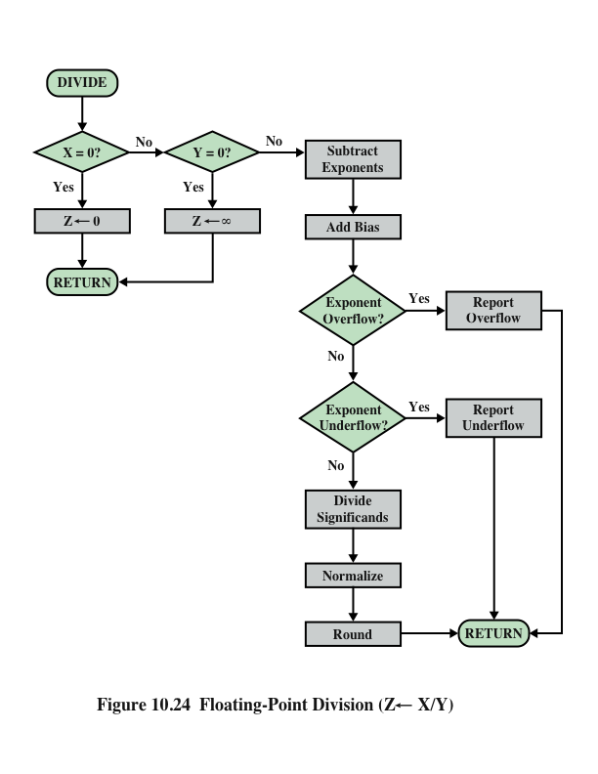
Kayan Noktalı Bölme
Notes:
Finally, let us consider the flowchart for division depicted in Figure 10.24.
Again, the first step is testing for 0. If the divisor is 0, an error report is issued,
or the result is set to infinity, depending on the implementation. A dividend of 0
results in 0. Next, the divisor exponent is subtracted from the dividend exponent.
This removes the bias, which must be added back in. Tests are then made for exponent
underflow or overflow.
The next step is to divide the significands. This is followed with the usual normalization
and rounding.

Slide 52
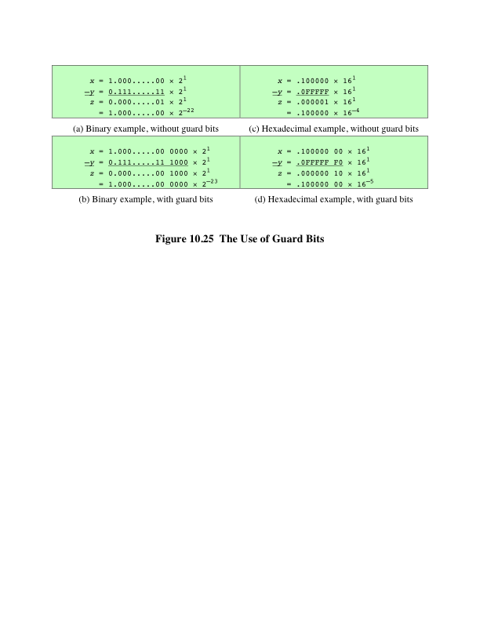
Duyarlılık Hususları
Guard Bits
Notes:
We mentioned that, prior to a floating-point operation, the exponent
and significand of each operand are loaded into ALU registers. In the case of the
significand, the length of the register is almost always greater than the length of the
significand plus an implied bit. The register contains additional bits, called guard
bits, which are used to pad out the right end of the significand with 0s.

Slide 53
Duyarlılık Hususları
Yuvarlama
IEEE standard approaches:
En yakına yuvarlama:
Sonuç en yakın temsil edilebilir sayıya yuvarlanır.
+∞ ‘a yuvarlama:
Sonuç artı sonsuza doğru yuvarlanır.
-∞ ‘a yuvarlama:
Sonuç artı sonsuza doğru yuvarlanır.
0’a yuvarlama:
Sonuç 0’a doğru yuvarlanır.
Notes:
Another detail that affects the precision of the result is the rounding
policy. The result of any operation on the significands is generally stored in a longer
register. When the result is put back into the floating-point format, the extra bits
must be eliminated in such a way as to produce a result that is close to the exact
result. This process is called rounding.
A number of techniques have been explored for performing rounding. In fact,
the IEEE standard lists four alternative approaches:
• Round to nearest: The result is rounded to the nearest representable number.
• Round toward H: The result is rounded up toward plus infinity.
• Round toward +∞: The result is rounded down toward negative infinity.
• Round toward -∞: The result is rounded toward zero.
Let us consider each of these policies in turn. Round to nearest is the default
rounding mode listed in the standard and is defined as follows: The representable
value nearest to the infinitely precise result shall be delivered.
The standard also addresses the special case of extra bits of the form 10000.…
Here the result is exactly halfway between the two possible representable values.
One possible technique here would be to always truncate, as this would be the simplest
operation. However, the difficulty with this simple approach is that it introduces
a small but cumulative bias into a sequence of computations. What is required
is an unbiased method of rounding. One possible approach would be to round up or
down on the basis of a random number so that, on average, the result would be unbiased.
The argument against this approach is that it does not produce predictable,
deterministic results. The approach taken by the IEEE standard is to force the result
to be even: If the result of a computation is exactly midway between two representable
numbers, the value is rounded up if the last representable bit is currently 1 and
not rounded up if it is currently 0.

Slide 54
Aralık Aritmetiği
Her sonuç için iki değer üreterek kayan nokta hesaplamaları hatalarını kontrol etmek ve izlemek için etkili bir yöntem sağlar
İki değer, gerçek sonucu içeren bir aralığın alt ve üst uç noktaları ile ilişkilidir
Aralık genişliği, sonucun doğruluğunu gösterir
Bitiş noktaları temsil edilemiyorsa, aralık bitiş noktası sırasıyla yukarı ve aşağı doğru yuvarlanır
Üst ve alt sınırlar arasındaki mesafe yeterince dar ise, yeterince kesin bir sonuç elde edilmiştir
Aralık aritmetiğinin uygulanmasında eksi sonsuzluk ve artıya yuvarlama faydalıdır.
Kesme
Sıfıra doğru yuvarlar
Ekstra bitler göz ardı edilir
Basit bir tekniktir
İşlemde tutarlı bir sıfır eğilimi
Eğilim ciddidir, sıfır olmayan ekstra bitlerin bulunduğu her işlemi etkilediğinden
Notes:
The next two options, rounding to plus and minus infinity, are useful in implementing
a technique known as interval arithmetic. Interval arithmetic provides an
efficient method for monitoring and controlling errors in floating-point computations
by producing two values for each result. The two values correspond to the
lower and upper endpoints of an interval that contains the true result. The width of
the interval, which is the difference between the upper and lower endpoints, indicates
the accuracy of the result. If the endpoints of an interval are not representable,
then the interval endpoints are rounded down and up, respectively. Although
the width of the interval may vary according to implementation, many algorithms
have been designed to produce narrow intervals. If the range between the upper
and lower bounds is sufficiently narrow, then a sufficiently accurate result has been
obtained. If not, at least we know this and can perform additional analysis.
The final technique specified in the standard is round toward zero. This is,
in fact, simple truncation: The extra bits are ignored. This is certainly the simplest
technique. However, the result is that the magnitude of the truncated value is always
less than or equal to the more precise original value, introducing a consistent bias
toward zero in the operation. This is a serious bias because it affects every operation
for which there are nonzero extra bits.

Slide 55
İkili Kayan Noktalı Aritmetik için IEEE Standartı
Sonsuzluk
Aşağıda verilen sonsuzluk değerleri ile gerçek aritmetiğin sınırlayıcı örneği olarak kabul edilir:
- ∞ < (her sonlu sayı) < + ∞
Örneğin:
5 + (+ ∞ ) = + ∞ 5÷ (+ ∞ ) = +0
5 - (+ ∞ ) = - ∞ (+ ∞ ) + (+ ∞ ) = + ∞
5 + (- ∞ ) = - ∞ (- ∞ ) + (- ∞) = - ∞
5 - (- ∞ ) = + ∞ (- ∞ ) - (+ ∞ ) = - ∞
5 * (+ ∞ ) = + ∞ (+ ∞ ) - (- ∞ ) = + ∞
Notes:
IEEE 754 goes beyond the simple definition of a format to lay down specific practices
and procedures so that floating-point arithmetic produces uniform, predictable
results independent of the hardware platform. One aspect of this has already been
discussed, namely rounding. This subsection looks at three other topics: infinity,
NaNs, and subnormal numbers.
Infinity arithmetic is treated as the limiting case of real arithmetic, with
the infinity values given the following interpretation:
- ∞ < (every finite number) < + ∞
With the exception of the special cases discussed subsequently, any arithmetic
operation involving infinity yields the obvious result.

Slide 56
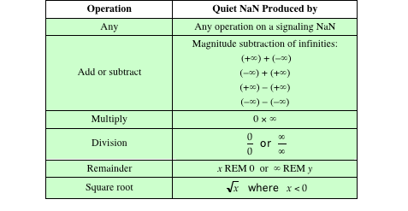
İkili Kayan Noktalı Aritmetik için IEEE Standartı
Quiet and Signaling NaNs
Sinyal NaN, bir işlenen olarak görüldüğünde geçersiz bir çalışma istisnasını sinyal gönderir
Quiet NaN, bir istisna sinyali vermeden hemen hemen her aritmetik işlem boyunca ilerler.
Tablo 10.7
Bir Quiet NaN Üretmek için İşlemler
Notes:
A NaN is a symbolic entity encoded in floating-point
format, of which there are two types: signaling and quiet. A signaling NaN
signals an invalid operation exception whenever it appears as an operand. Signaling
NaNs afford values for uninitialized variables and arithmetic-like enhancements
that are not the subject of the standard. A quiet NaN propagates through almost
every arithmetic operation without signaling an exception. Table 10.7 indicates
operations that will produce a quiet NaN.
Note that both types of NaNs have the same general format (Table 10.4): an
exponent of all ones and a nonzero fraction. The actual bit pattern of the nonzero
fraction is implementation dependent; the fraction values can be used to distinguish
quiet NaNs from signaling NaNs and to specify particular exception conditions.

Slide 57
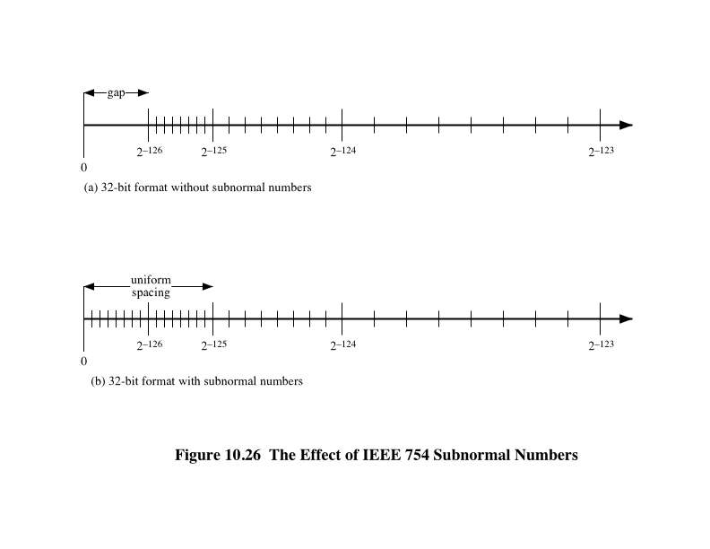
İkili Kayan Noktalı Aritmetik için IEEE Standartı
Subnormal Sayılar
Notes:
Subnormal numbers are included in IEEE 754 to handle
cases of exponent underflow. When the exponent of the result becomes too small
(a negative exponent with too large a magnitude), the result is subnormalized by
right shifting the fraction and incrementing the exponent for each shift until the
exponent is within a representable range.
Figure 10.26 illustrates the effect of including subnormal numbers. The representable
numbers can be grouped into intervals of the form [2^{n}, 2^{n+1}]. Within each
such interval, the exponent portion of the number remains constant while the fraction
varies, producing a uniform spacing of representable numbers within the interval. As
we get closer to zero, each successive interval is half the width of the preceding interval
but contains the same number of representable numbers. Hence the density of
representable numbers increases as we approach zero. However, if only normal numbers
are used, there is a gap between the smallest normal number and 0. In the case of
the 32-bit IEEE 754 format, there are 2²³ representable numbers in each interval, and
the smallest representable positive number is 2⁻¹²⁶. With the addition of subnormal
numbers, an additional 2²³ - 1 numbers are uniformly added between 0 and 2⁻¹²⁶.
The use of subnormal numbers is referred to as gradual underflow [COON81].
Without subnormal numbers, the gap between the smallest representable nonzero
number and zero is much wider than the gap between the smallest representable
nonzero number and the next larger number. Gradual underflow fills in that gap
and reduces the impact of exponent underflow to a level comparable with roundoff
among the normal numbers.

Slide 58
Özet
Computer
Arithmetic
Bölüm10
Tamsayı Aritmetiği
Negation
Toplama ve Çıkarma
Çarpma
Bölme
Kayan noktalı Aritmetiği
Toplama ve Çıkarma
Çarpma ve Bölme
Duyarlılık hususları
İkili kayan noktalı aritmetiği için IEEE standartı
ALU
Tamsayı temsili
İşaretli genlik temsili
İkiye tümleme temsili
Aralık uzantısın
Sabit Noktalı temsil
Kayan-noktalı temsil
Prensipler
İkili kayan noktalılar için IEEE standartı
Notes:
Chapter 10 summary.

